Slide 1
Art of Persuasion
Unit 9 – Technical English

Slide 2
OBJECTIVE_______________________
To convince your audience to adopt your point of view
To convince your audience to take a specific course of action

Slide 3
USING PERSUASION_______________
When would you use persuasion?
  Make others to understand or accept your ideas, beliefs, perspective
  Make others to act upon your ideas
  Sell something—product or yourself

Slide 4

ARGUMENT______________________

Slide 5
ARGUMENT______________________
Argument
=
Presenting your ideas & evidence

Slide 6

GOAL___________________________
…is your goal.

Slide 7

3 TYPES OF PERSUASION___________
Ethos
Ethics / Credibility
Logos
Logic
Pathos
Emotions

Slide 8
ETHOS PERSUASION_______________
We tend to believe people whom we respect or trust.
ETHICS & CREDIBILITY
→ Or if speaker/writer has an expertise in a specific subject

Slide 9

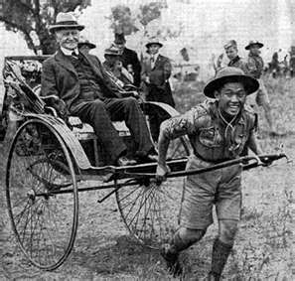
ETHOS PERSUASION_______________
Which person would you trust as a basketball coach?

Slide 10
LOGOS PERSUASION______________
Using facts and reason.
2 Methods of Reasoning
Deductive
  → Start with general premises then conclude with a specific concept
Inductive
→ Use specific evidence to support a
general conclusion

Slide 11



DEDUCTIVE______________________
Example
All oranges are fruits (Premise #1)
Fruits grow above ground (Premise #2)
Therefore, all oranges grow above ground (Conclusion)

Slide 12



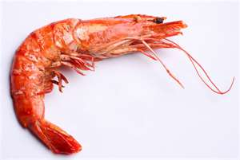
INDUCTIVE_______________________
Example
Your stomach hurts after dinner.
You ate shrimp for dinner.
Therefore your stomach hurts because you eat shrimp for dinner.

Slide 13
PATHOS PERSUASION_____________
Appeal to emotions
Use an emotional method
Create an emotional response
→ Focus on beliefs or sympathy

Slide 14





PATHOS PERSUASION_____________
Example
Boy wants Toy

Slide 15
ASSIGNMENT_____________________
Prepare 5-minute Sales Presentation
  Using persuasion, prepare a sales presentation
  SUBJECT: A rock
  Use at least 5 vocabulary words from Unit 9
Group Presentation ⬄
(At least 2 people present)

